Slide 1
Style Transfer
Peter Victoratos
CSC 441

Slide 2
What is it?
this.

Slide 3
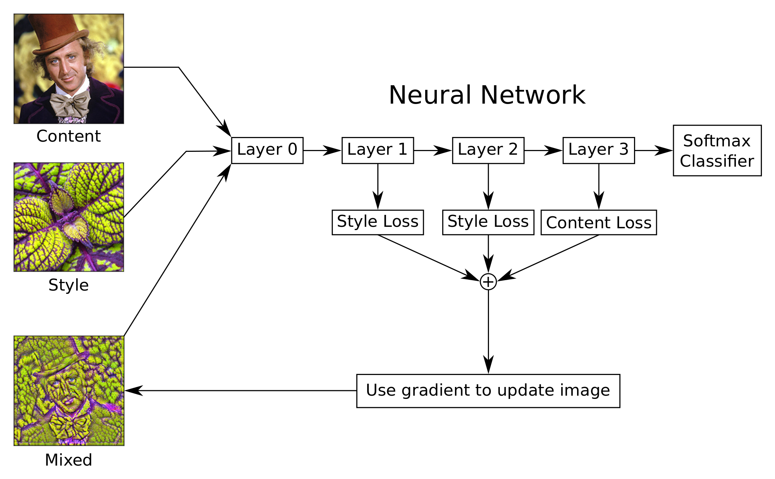
How does one make this?
+more layers

Slide 4
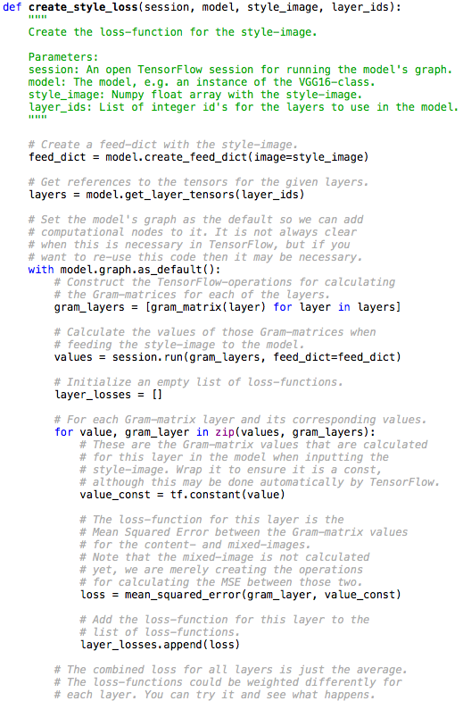
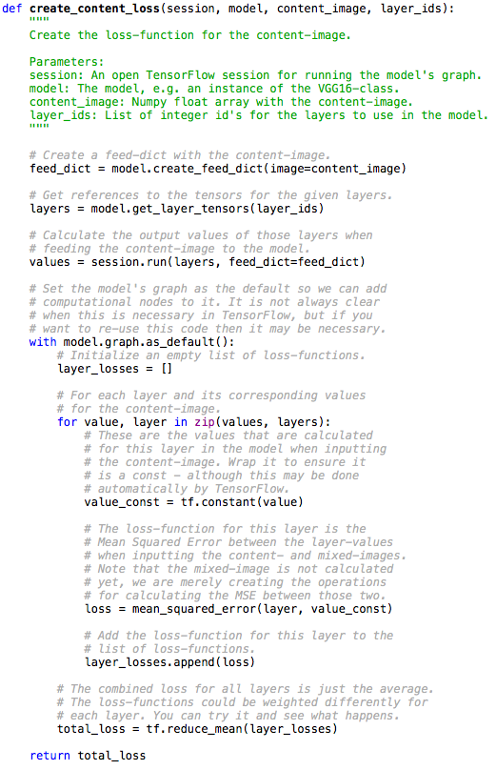
Loss Functions

Slide 5
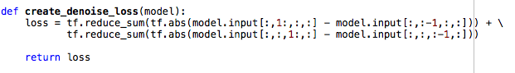
Loss Functions (cont.)
Content Loss: mean squared error of the feature activations of the raw content image
Gram Matrix: dot product matrix of the feature activation, copied from
Style Loss: mean squared error from the gram matrix rather than the raw images
Denoise Loss: convolve over image to maintain content integrity

Slide 6
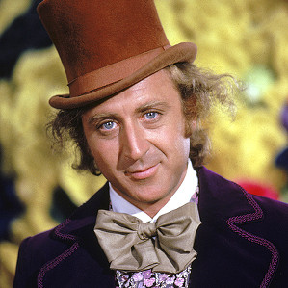

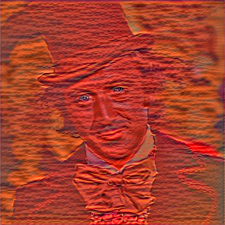
Let’s Run it
content image
style image
mixed image

Slide 7
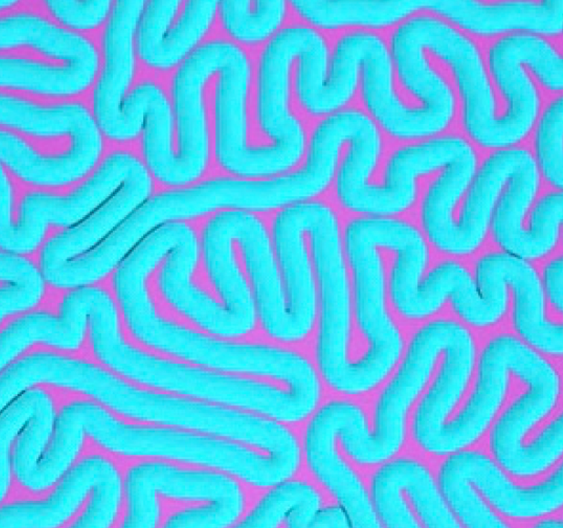
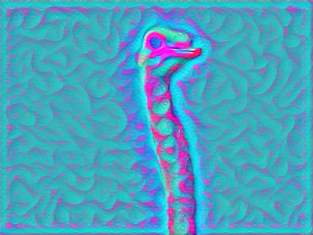
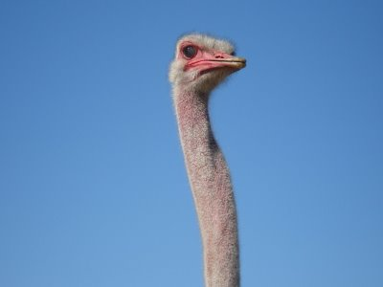

Slide 8
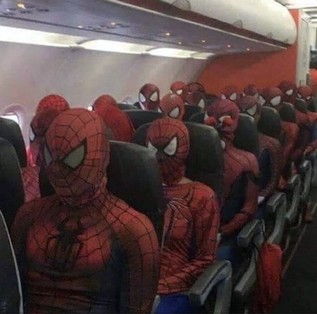
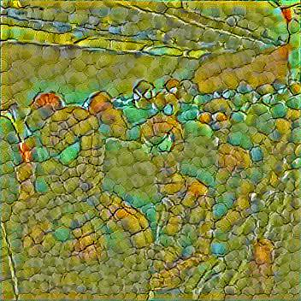

Slide 9
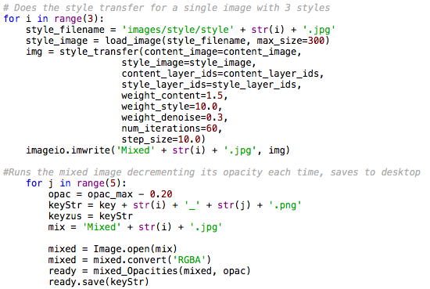
Creating the gif - style transfer
Reads in style and content image
Performs style transfer for a single, still content image using three styles
Recreates each stylization with different opacities

Slide 10
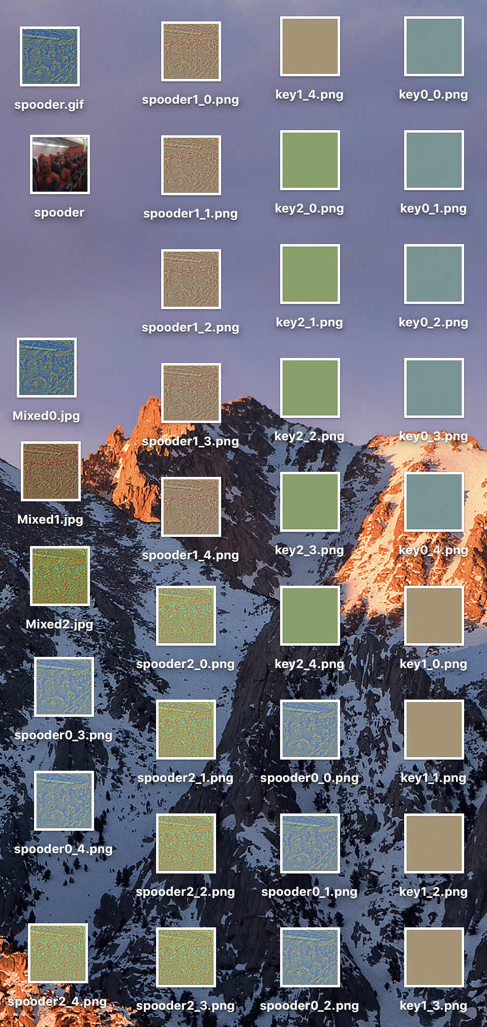
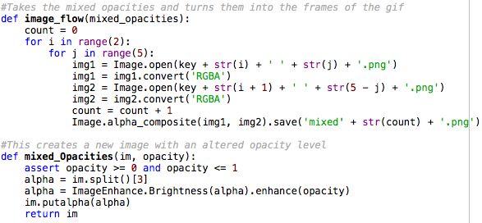
Creating the gif - image_flow()

Slide 11
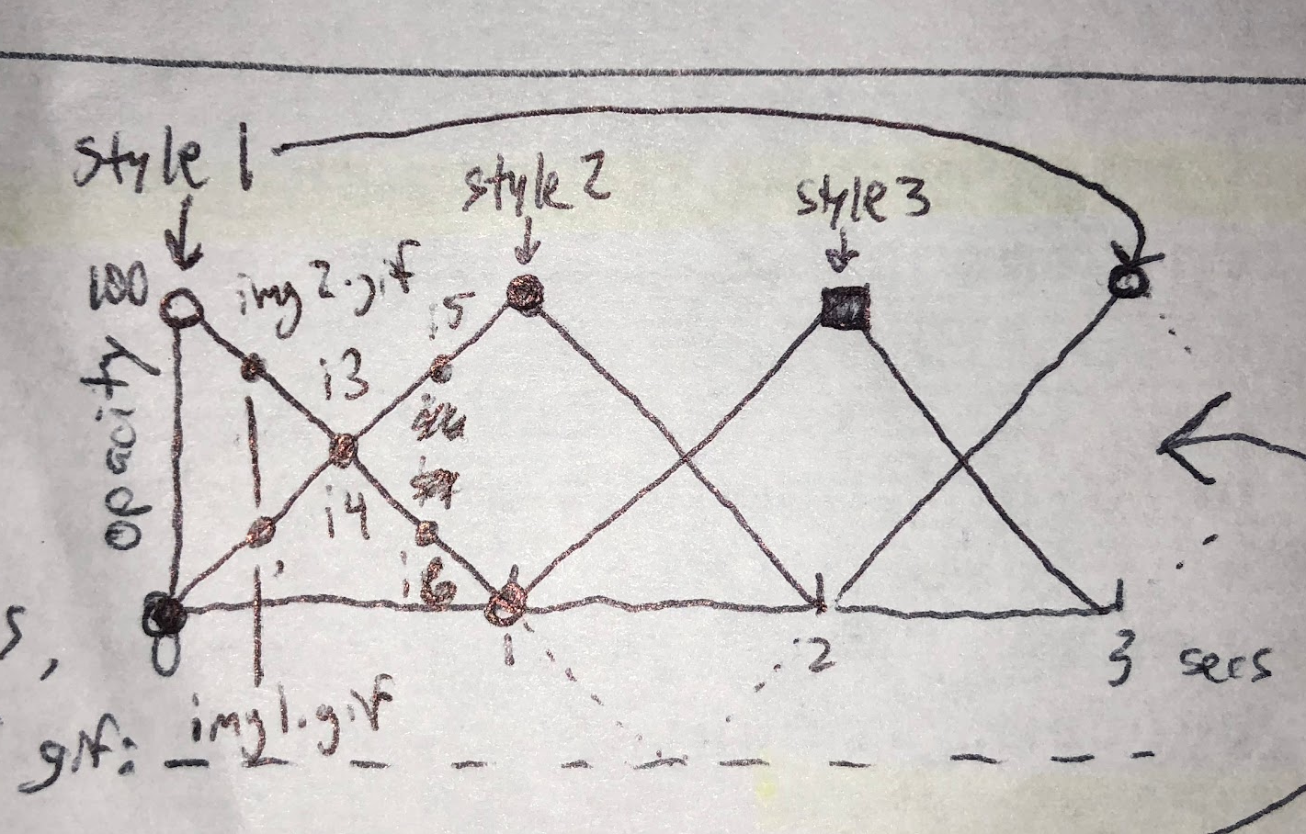
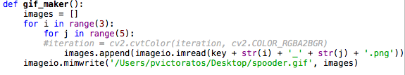
Scientific Drawing

Slide 13
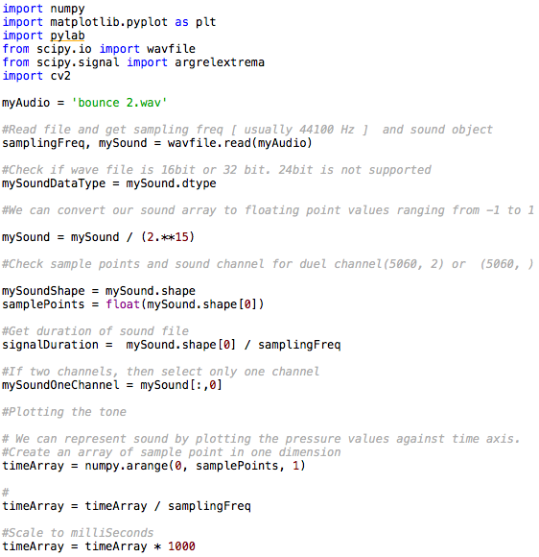
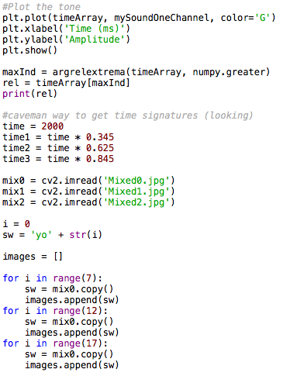
Audio Reader

Slide 14
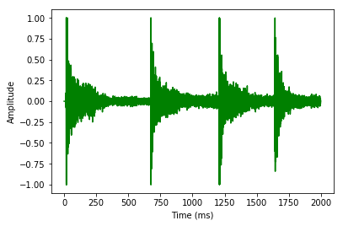
What it sees

Slide 15
Live Demo!

Slide 16
Bibliography
https://www.youtube.com/watch?v=LoePx3QC5Js video tutorial of transfer model
https://github.com/Hvass-Labs/TensorFlow-Tutorials/blob/master/15_Style_Transfer.ipynb transfer model
https://stackoverflow.com/questions/24731035/python-pil-0-5-opacity-transparency-alpha for the opacity
https://stackoverflow.com/questions/753190/programmatically-generate-video-or-animated-gif-in-python for the gif
https://stackoverflow.com/questions/43284049/spectrogram-of-a-wave-file spectrogram
https://stackoverflow.com/questions/33311153/python-extracting-and-saving-video-frames making video

